Slide 1
Talent Development
At HCL

Slide 2
Test Report Generation

Slide 3
Agenda
Introduction
Extent Report
Features
Demo

Slide 4
Quality of a good Test Report
Brevity:
A report should be short and concise
It should clearly state the proportion of total no. of success or failure
Trackability
Captures all the footprints that could lead to the root cause of a failure
Traceability:
It must provide the ability to review the following
Historical data for test cases and failures
Age of a particular failure
Sharable:
It should support a format which you can share through email or integrate with CI tools like Jenkins/Bamboo
Test Coverage
Test coverage of the module under test
Test coverage of the application under test.

Slide 5
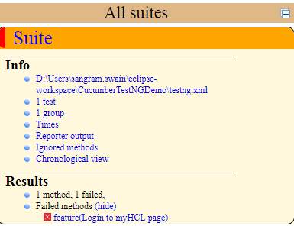
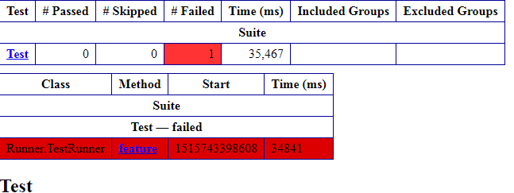
TestNG Reporting
TestNG generates 2 report
Detailed Report: Generated through index.html file in folder <test-output>
Summary Report: Generated through emailable-report.html

Slide 6
ITestListener
User can generate report using an interface iTestListner.
User can create any class and implement this interface.
User need to override all its method and customize as per requirement.
On the source file where the reporting needs to be implemented, user needs to use the annotation @Listeners(<PackageName>.<ClassName>.class)

Slide 7
Extent Report Library
Extent Report library comes with a rick set of feature
Ability to generate dynamic HTML logs
Represents test case status with the help of PIE Charts
Generates step-by-step test case summary.
Ability to filter reports based on test status.
It maintains execution history.
It captures details like OS, Memory, Java version and so on
You can attach error screenshots within the report

Slide 8
Extent Report Library
Pre-requisite to generate Extent Reports
Java should be installed.
TestNG should be installed.
Download Extent Report jar and configure in the project.
Download extent-config.xml and configure in the project.

Slide 9
Code
Download the code from - https://github.com/sangramkswain/HCLPuneTraining
File Name – ExtentReporting.zip

